Slide 1

Police FI
Ernest, Thuo and Stanslaus

Slide 2
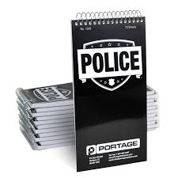


How police do investigations?
Taking notes

Slide 3
Police Routine
Detective
Pursue people who break the law
Gather facts and evidence for criminal cases
Conduct interviews
Examine records

Slide 4
Nature of work
Writing reports
Maintaining crime records
Patrol their jurisdictions
Investigate any weird or unusual activities

Slide 5
At the end
Too much Data
Shelves of note books
Incomplete Data
Data Consistency
Data Back up
labeling
Theft of note books
Loosing Notebooks
Storage space
Manual data center
Hard to triangulate
Un managed data center
Record management

Slide 6

Solution
Implementing mobile field interview App.(Police FI)
Taking notes and specifications of suspects including relatives, friends, family and residence.
The notes have pre-filled fields/questions
Saves and uploads to the online database
Easy to access information by the police

Slide 7

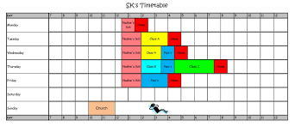

FI Future Version
recorder
scheduler
Civilians to report crime
Take pictures of suspects

Slide 8
Police FI-Target Market
The police investigators
In future
Private investigators and researchers.

Slide 9
Revenue Model
Paid downloads
Free version and a pro
version
Royalties and licensing

Slide 10
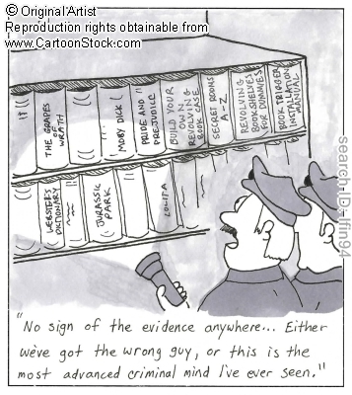
No data found??
No data no evidence no case
Can burn, bad labeling

Slide 11



Architecture
Interface
Database
API
Stanslaus
Thuo
Ernest

